Slide 1
ISLAMIC VALUE AND PRINCIPLE IN ORGANIZATION
Dr. Muthia Pramesti, SE, MM

Slide 2
The current Facts
Religion is something which has the capability to affect a human brain, body, physical activities and cognitive processes as well as his actions
It impacts the business environment as well as the working of organization

Slide 3
The current Facts
Our Qurans gives the best and authentic reference and it facilitates the human cognition processes
In almost all the countries of the world organization is studied and observed as components which implement Islamic rules and regulations

Slide 4

Islamic Value in Organization
A set of values or belief systems of the Qur'an and the Sunnah about the work.
(Ali, 1987)

Slide 5

Three attributes in Islamic
Tawheed
Shariah
Akhlaq

Slide 6
The power of al quran and hadist
It tells the differences between the right and wrong, good and bad, halal and haram, deeds and sins.
It will increase the motivation, satisfaction and dedication towards the life, organization and working or job.

Slide 7

By Learning organizational behavior in Islamic persperctive:
It explains the effects of religion on ones and organizational life also on the employee, managers and labour in their decisions, actions, initiatives and approaches.

Slide 8

The Islamic PRINCIPLE OF ORGANIZATION regards to:
The aim of working not just to finish the job, but to encourage the growth of the balance of personal and social relationships.

Slide 9

The Islamic PRINCIPLE OF ORGANIZATION regards to:`
The intention (Accompanying intentions) rather than the work (work result)
(Ali, 1998).

Slide 10

The Islamic PRINCIPLE OF ORGANIZATION regards to:
Individual affirm that justice and kindness in the workplace is a necessity for the welfare of the people and no one has their wages delayed.
(Ali, 1998).

Slide 11

The Islamic PRINCIPLE OF ORGANIZATION regards to:
Islamic work ethic states that life without work is meaningless and carrying out economic activities is an obligation
(Ali, 1998).

Slide 12
Islamic Approach to Organization
1. Honesty
2. Fairness
3. Justice in employees employer relationship.
4. Learning skills
5. Struggle for good work
Ashtankar (2015
Stress for the principles of management and
work ethics
For benefit of community.

Slide 13
Islamic Approach to Organization
Transparent
Responsible
Committed to serve the public interest
an orientation that shape and influence the engagement and participation of market participants (workers), without jeopardizing the welfare of the other actors or the public.

Slide 14

The Islamic work ethic regards to:
Work is more than personal enjoyment, economically, socially, and psychologically.

Slide 15
Define
“Organizational Behavior” (OB)
LO 3
Organizational behavior (OB) is a field of study that investigates the impact that individuals, groups, and structure have on behavior within organizations for the purpose of applying such knowledge toward improving an organization’s effectiveness.
Notes:
Organizational behavior (OB) is a field of study that investigates the impact that individuals, groups, and structure have on behavior within organizations for the purpose of applying such knowledge toward improving an organization’s effectiveness. More specifically, OB explores motivation; leader behavior and power; interpersonal communication; group structure and processes; attitude development and perception; change processes; conflict and negotiation; and work design.

Slide 16
Show the Value to
OB of Systematic Study
.
LO 4
Systematic Study of Behavior
  Behavior generally is predictable if we know how the person perceived the situation and what is important to him or her.
Evidence-Based Management (EBM)
  Complements systematic study.
  Argues for managers to make decisions based on evidence.
Intuition
  Systematic study and EBM add to intuition, or those “gut feelings” about “why I do what I do” and “what makes others tick.”
  If we make all decisions with intuition or gut instinct, we’re likely working with incomplete information.
Notes:
Many people say that the ideas and concepts of OB are common sense. However, the systematic study of OB has come closer to finding ways to predict the behavior of individuals and groups through an understanding of the situation and composition of the people. Evidence-based management (EBM) complements systematic study by basing managerial decisions on the best available scientific evidence.
“Intuition” is a decision-making approach advocated by numerous managers and pundits. However, if we make all decisions with intuition or gut instinct, we’re likely working with incomplete information. EBM and the systematic study of behavior enhance the understanding of these internal contributors to organization behavior.
The recent availability of “big data” shows promise for the field of OB, potentially providing evidence that can be used to support intuition and experience.

Slide 17
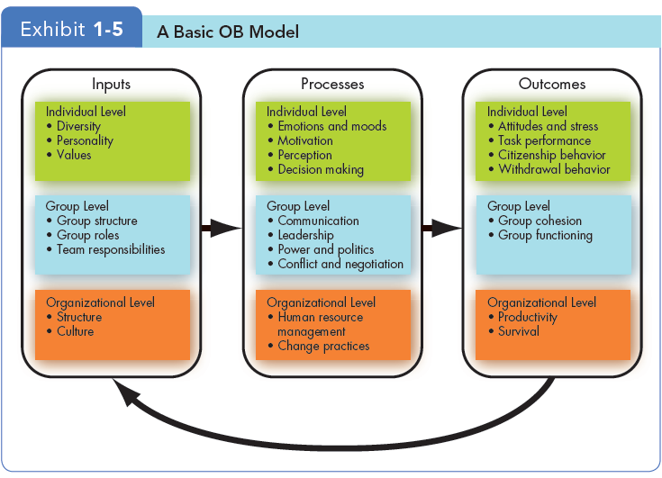
Three Levels of Analysis in
This Book’s OB Model
LO 8
Notes:
This book proposes three types of variables – inputs, processes, and outcomes – at three levels of analysis: individual, group, and organizational.
The basic OB model here proceeds from left to right, with inputs leading to processes and processes leading to outcomes. Notice that the model also shows that outcomes can influence inputs in the future.

Slide 18
Implications for Managers
Resist the inclination to rely on generalizations; some provide valid insights into human behavior, but many are erroneous.
Use metrics and situational variables rather than “hunches” to explain cause-and-effect relationships.
Work on your interpersonal skills to increase your leadership potential.
Notes:
This first chapter has provided a firm foundation that will be the basis for the study and application of concepts and practices that make the young professional more successful in productivity, job satisfaction, and career development. The systematic study of OB can improve predictability of behavior and, while it’s not prefect, it provides excellent roadmaps to guide managers and leaders. These studies help to ensure that contingencies are in place to better understand people’s behaviors and how to influence them for the success of the employee and the organization.

Slide 19
Implications for Managers
Improve your technical skills and conceptual skills through training and staying current with organizational behavior trends like “big data”.
Organizational behavior can improve your employees’ work quality and productivity by showing you how to empower your employees, design and implement change programs, improve customer service, and help your employees balance work-life conflicts.
Notes:
It is important for managers to develop their interpersonal “people skills” to be effective. Understanding OB makes their organizations work more effectively by improving productivity, reducing absenteeism, turnover, and deviant workplace behavior, and increasing organizational citizenship behavior and job satisfaction.

Slide 20
Research Finding
Ali et al. (2013); Zaman et al. (2012); Alhyasat (2012), Yousef (2000).
Higher organizational commitment, Innovation. Job Satisfaction and Performance, OCB.
Islamic Work Ethics

Slide 21
Thank you

